Slide 1
Sharknadoes Project 2
Group Members:
Jayden Le Blanc
Daniel Petrella
Max Tipton
Dave Damon
Visualization of Shark Attacks from around the world

Slide 2
Process
01 Found Data Source from Shark Research Institute website and downloaded to a csv file
02 Use jupyter notebooks to clean data frame and create SQLite database file
03 Create Flask App to create .json file
04 Use the json file to populate graphs
05 Display Web Page using JS. HTML, and CSS

Slide 3
Data Source
Source of Data: Global Shark Attack File from Shark Research Institute, Princeton, NJ.
The file is a .csv of 6580 shark attack incidents dating back to the year 1555.

Slide 4

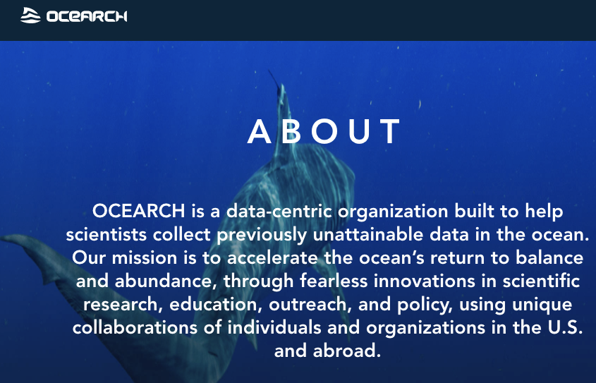
Adjacent Datasets
Global Marine Data: with an effort to secure sea surface temperatures, to plot against our shark activity,
the hopes of finding relationships with increased sea temperatures over the last century, and certainly the
last few decades. This information is housed by the National Centers for Environmental Information (NCEI)
at the National Oceanic & Atmospheric Administration (NOAA)
Ocearch.org, which tracks a large number of living marine wildlife. Perhaps an isolation of sharks in a specific location could be placed against our shark attack file to look for trends.

Slide 5
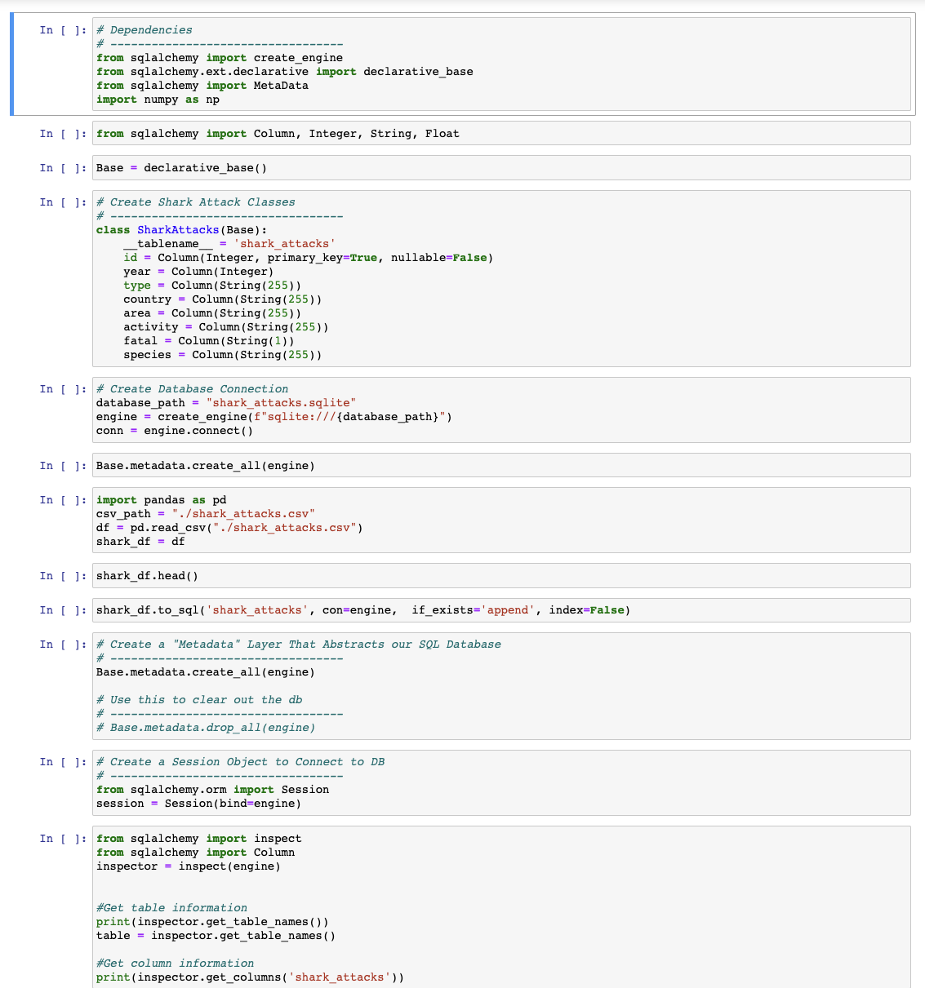
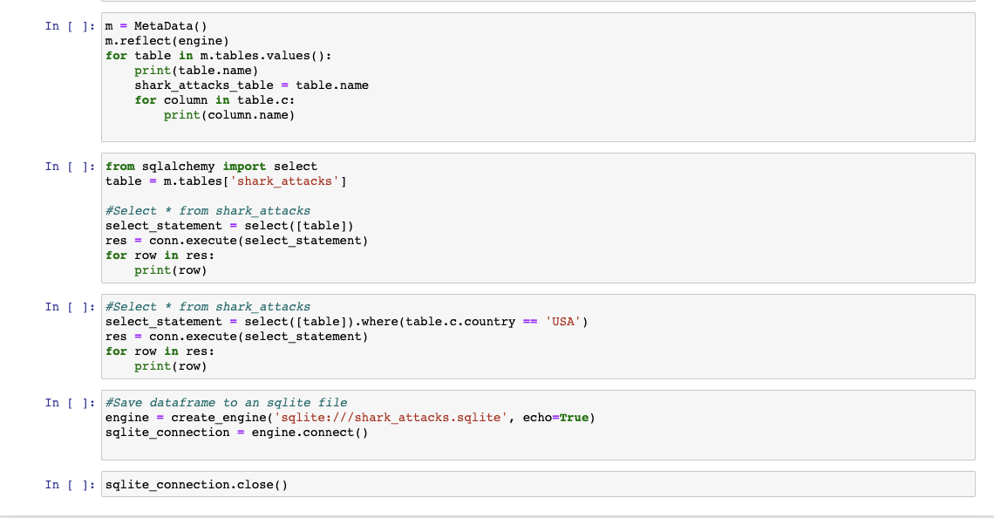
Jupyter Notebook

Slide 6
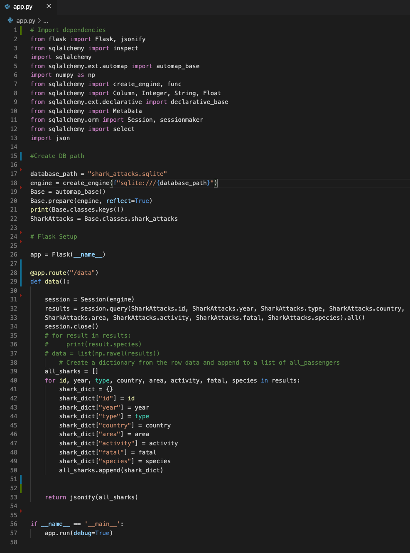
Flask App

Slide 7
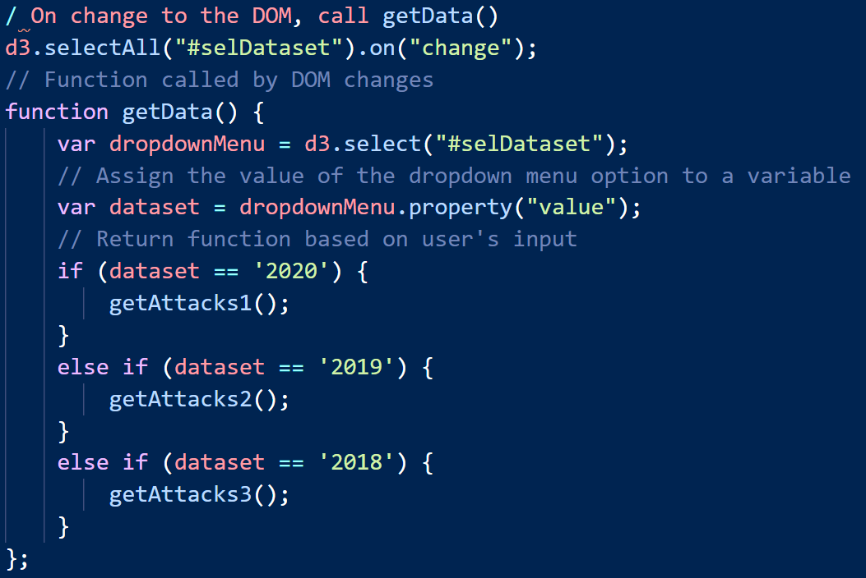
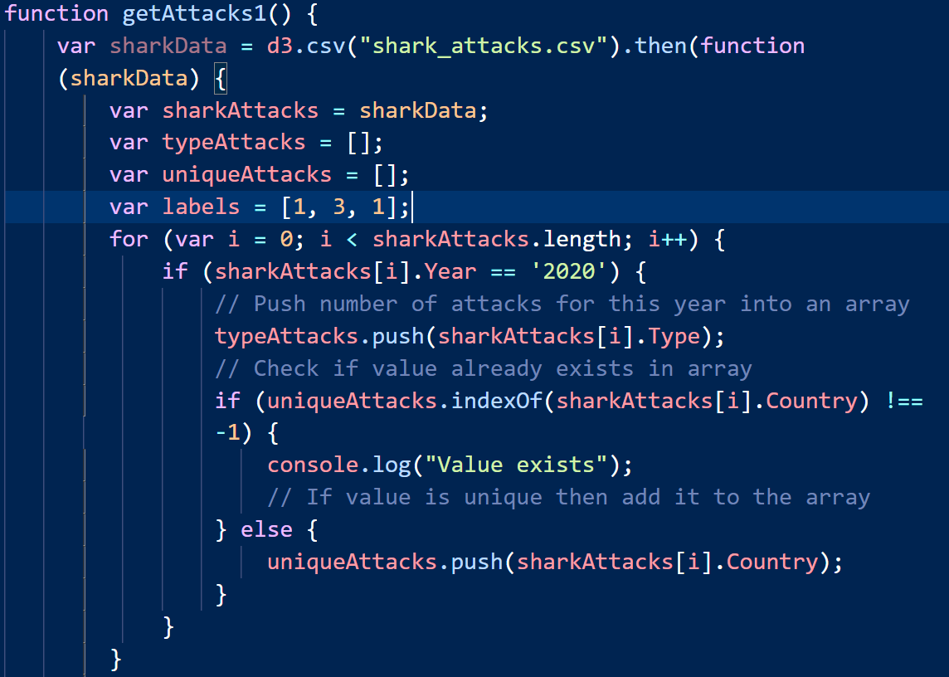
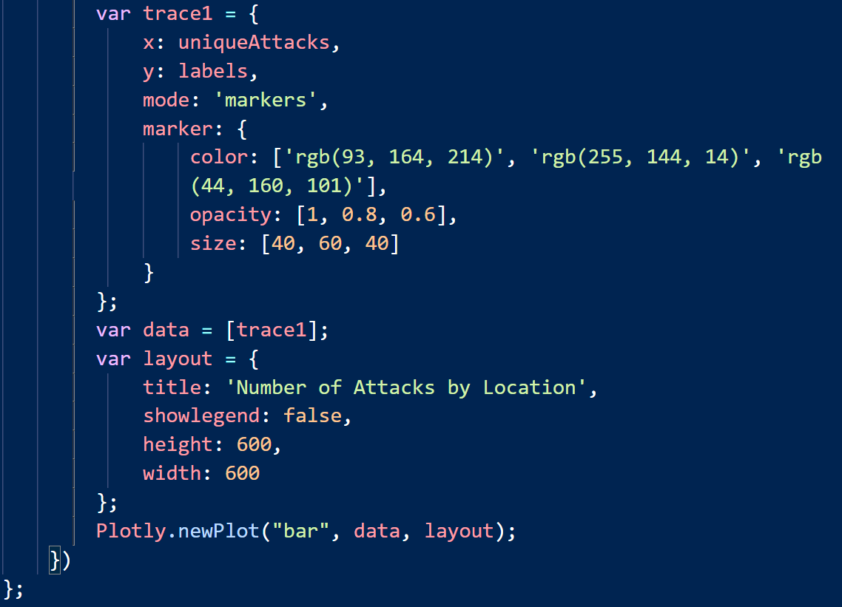
Javascript - Generate Bubble Charts

Slide 8
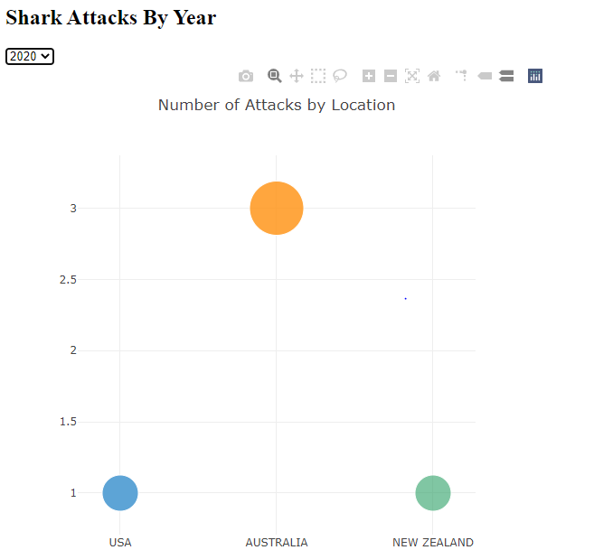
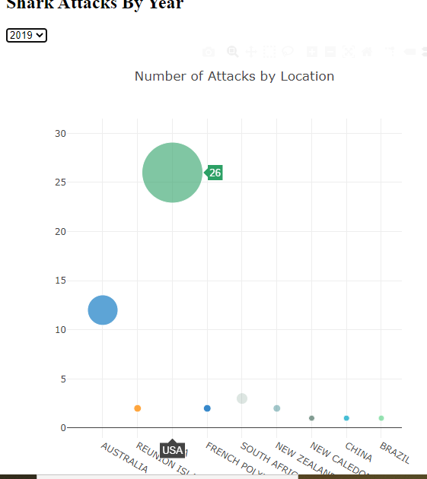
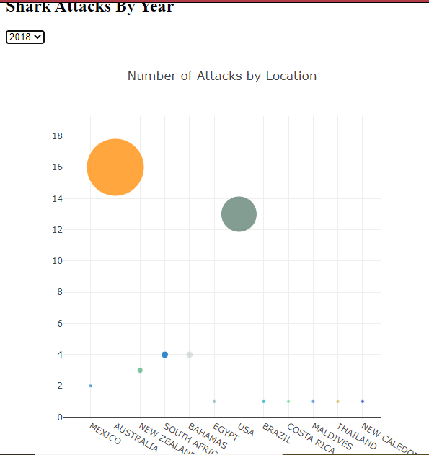
Bubble Charts for 3 different years

Slide 9
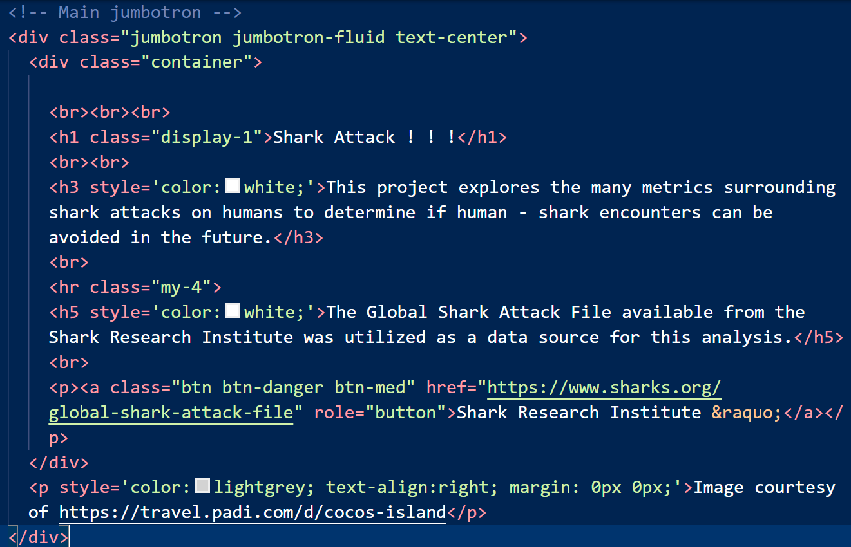
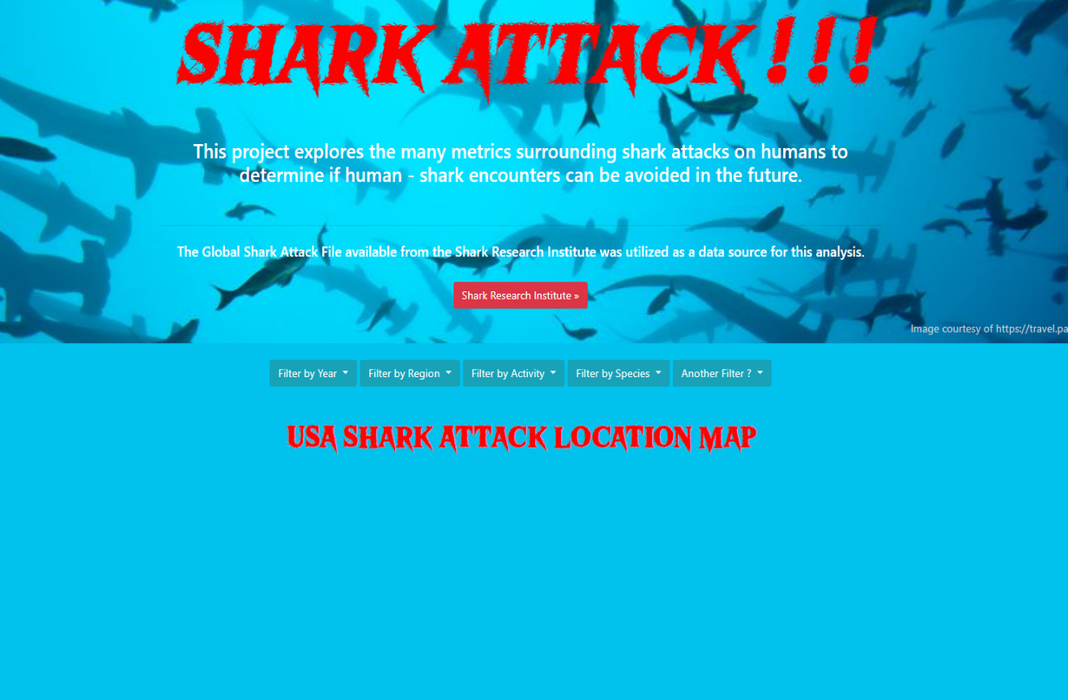
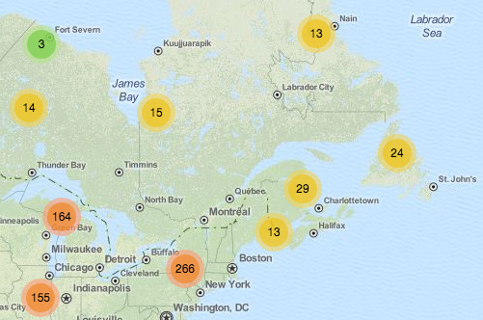
Web Page Development 01
The Web Page was set up to incorporate Bootstrap, Leaflet, Mapbox, and Plotly elements.
The design contains a Jumbotron feature at the top with a title and background image. Below that are multiple pulldown filter buttons to interact with the Leaflet Map below. The Leaflet map will have marker clusters that dynamically update with the map zoom level to indicate shark attacks at various locations.

Slide 10
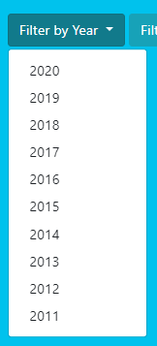
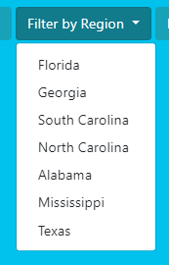
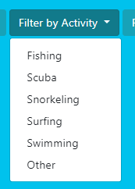
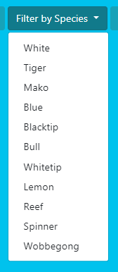
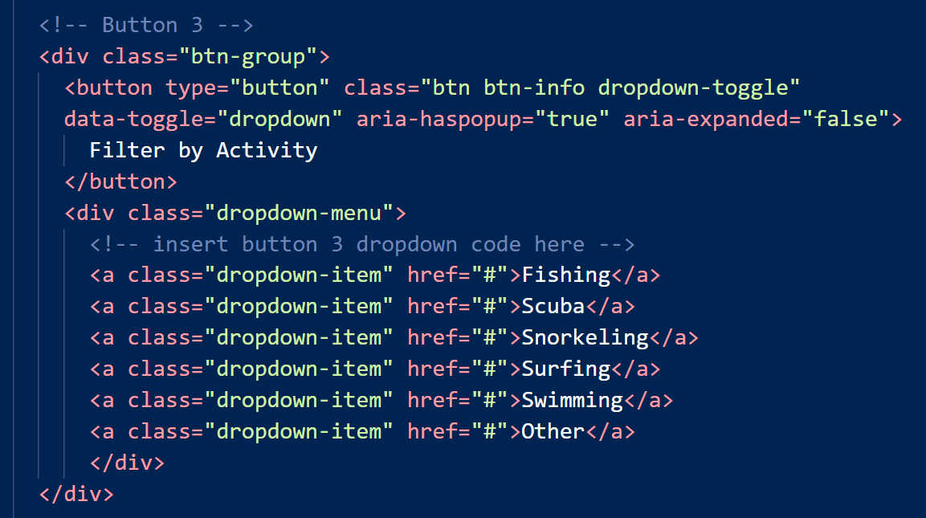
Web Page Development 02
The filter buttons on the dynamic Leaflet Map could allow users to filter the map markers displayed by Year, State, Activity, and Shark Species for the attacks.
Due to the lack of latitude and longitude data in our original dataset, it would be required to use the Mapbox Forward Geocoding API to search for coordinated by place name. This proved to be too complex in our limited timeframe, so this map was eliminated from our final Web Page.

Slide 11
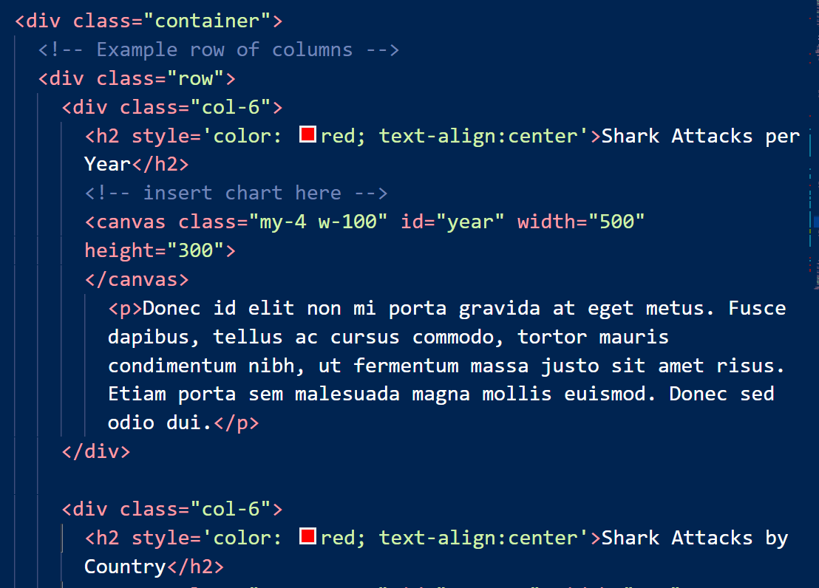
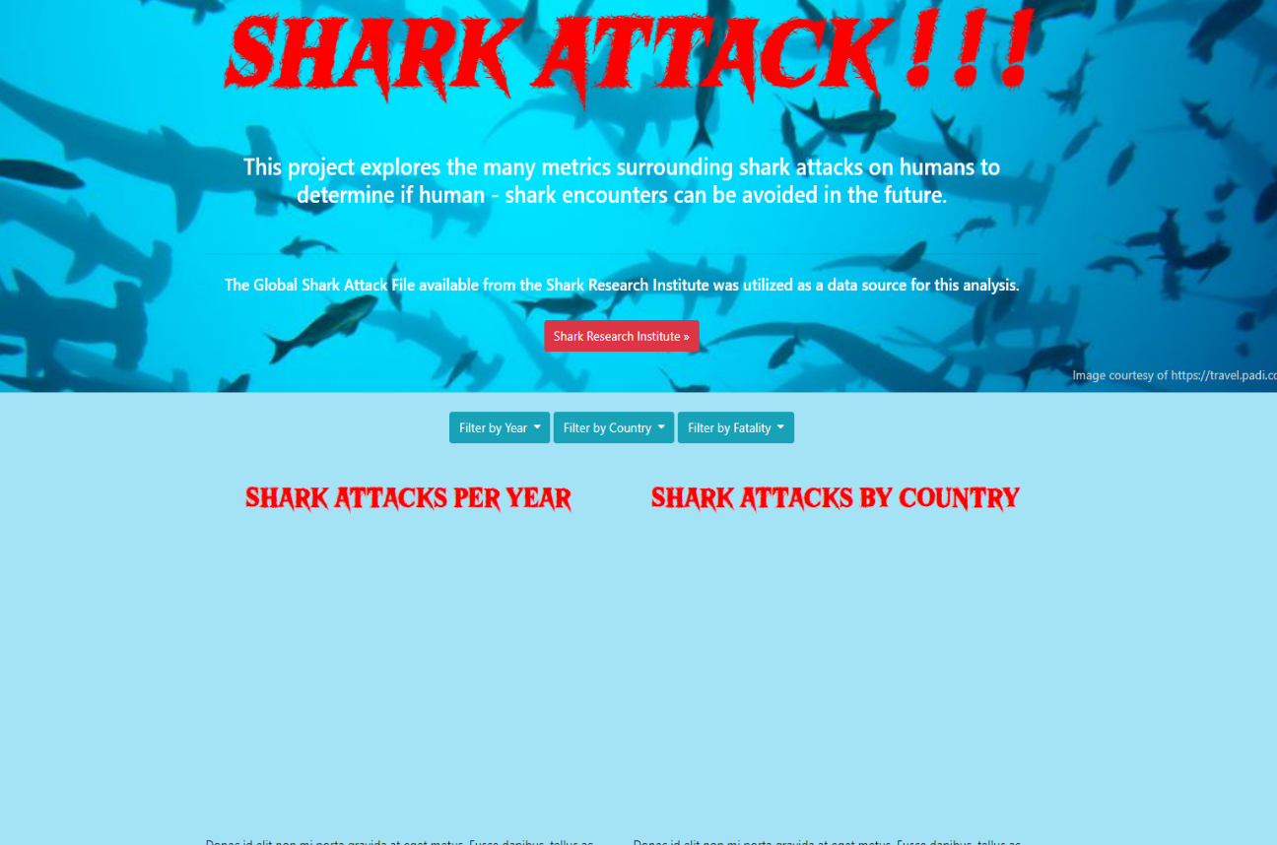
Web Page Development 03
The final version of the Web Page includes a Bar Chart with the Number of Shark Attacks vs. Year, with a filter by Country feature.
The second chart is a Pie Chart showing the Percentage of Attacks by Country, with the capability to select an individual Year.
Bar Chart
Placeholder
Pie Chart
Placeholder

Slide 12
THANK YOU

